Slide 1

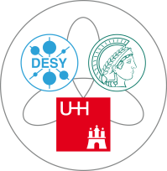
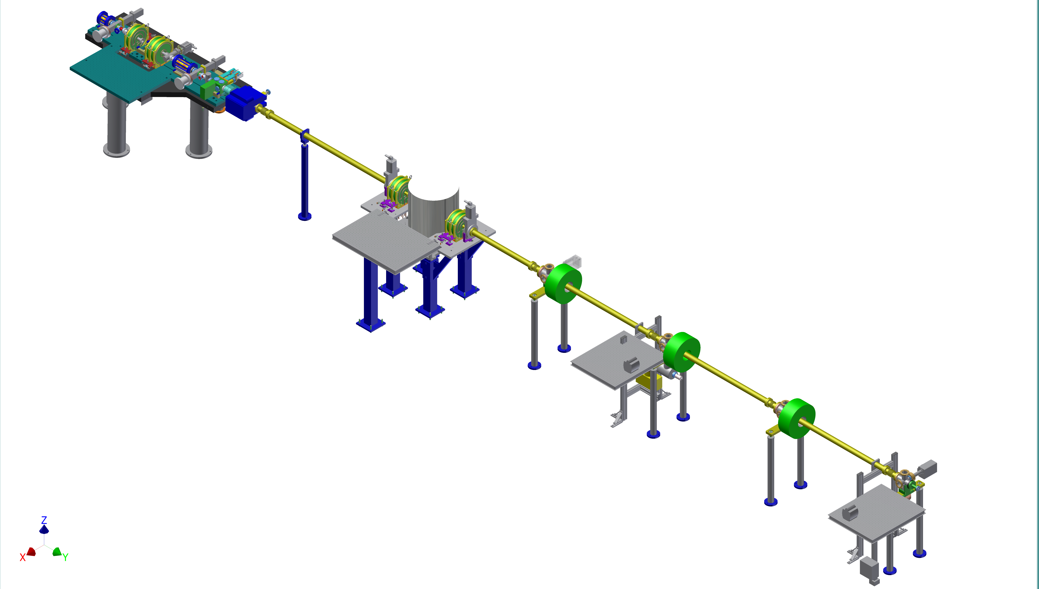
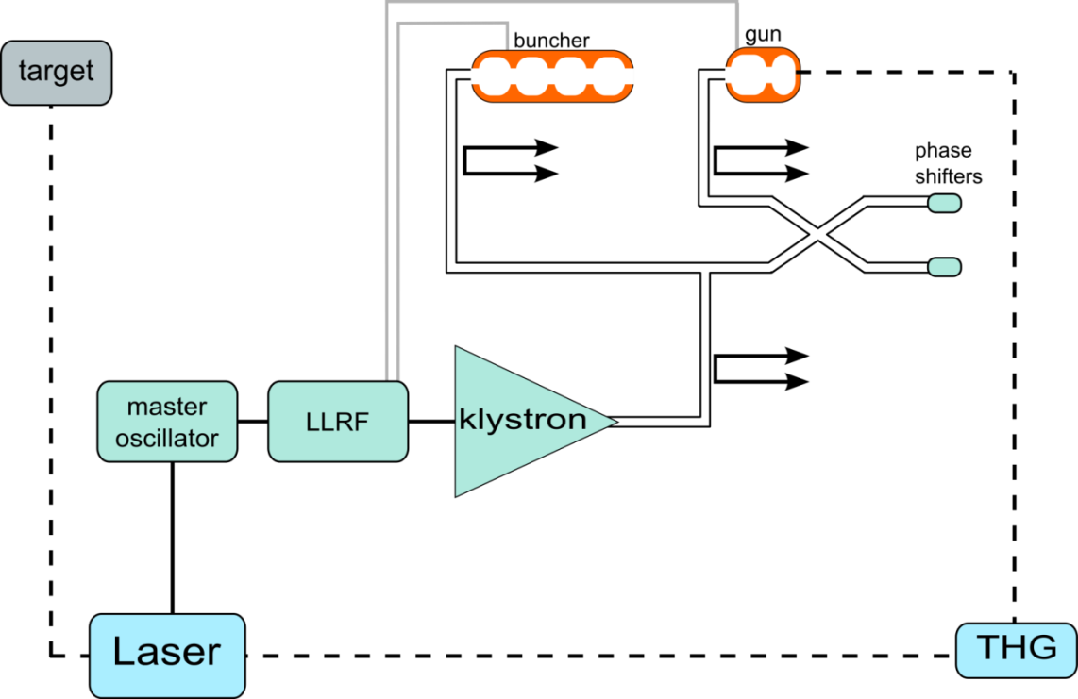
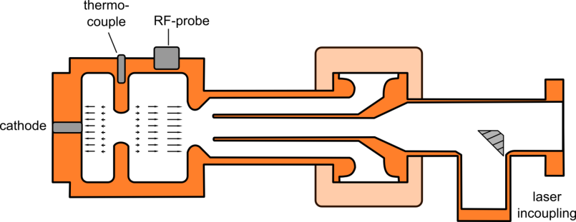
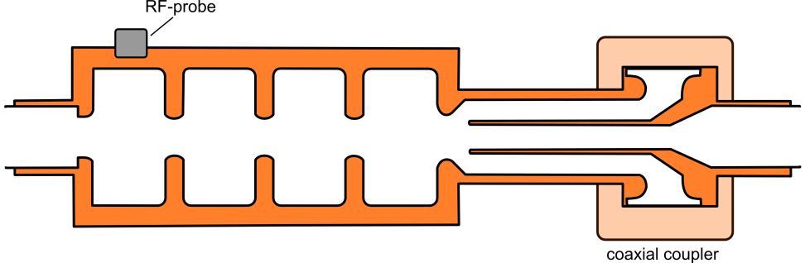
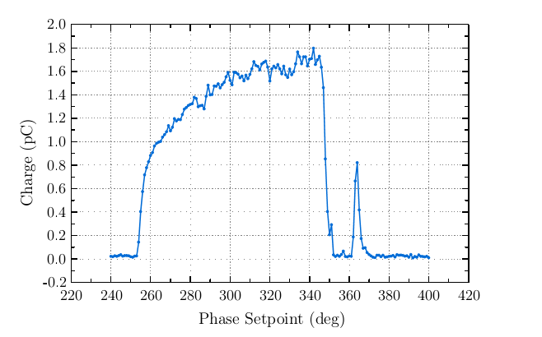
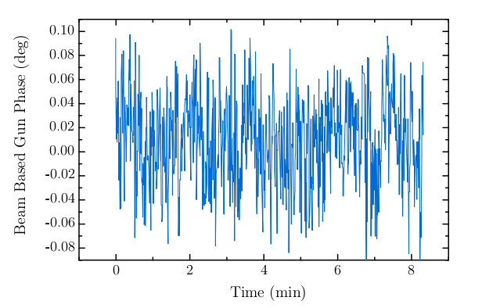
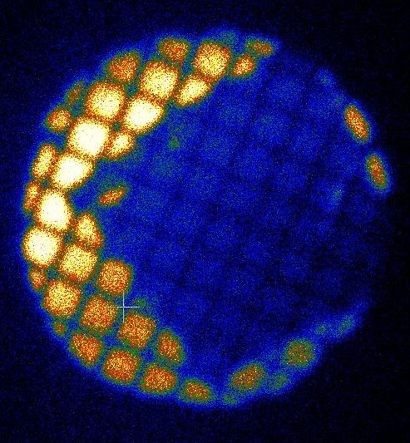
Towards ultrafast electron diffraction and dynamic microscopy with REGAE
S. Manz^{1*}, A. Casandruc¹, D. Zhang¹, J. Hirscht¹, S. Bayesteh³, S. Keskin¹, J. Nicholls⁴, T. Gehrke³,
F. Mayet³, M. Hachmann³, M. Felber², S. Jangam¹, H. Delsim-Hashemi² , H. Schlarb², M. Hoffmann²,
M. Hüning², T. Hasegawa¹, A. Marx¹, S. Hayes¹, K. Pichugin¹, G. Moriena^{4,}
G. Sciaini¹, S. Epp¹, M. Hada¹, K. Flöttmann², R. J. Dwayne Miller^{1,4}
1 Max Planck Research Department for Structural Dynamics, University of Hamburg - Center for Free Electron Laser Science, Hamburg, Germany
2 DESY Hamburg, Notkestrasse 85, 22607 Hamburg, Germany
3 Institute of Experimental Physics, CFEL, Luruper Chaussee 149, 22761 Hamburg, Germany
4 Departments of Chemistry and Physics, University of Toronto, Toronto, Ontario M5S 3H6, Canada
Motivation
First results
The relativistic electron gun for atomic exploration (REGAE) has been designed to study structure and dynamics in a wide range of systems. Aiming for a time resolution of far less than 100 fs, we plan to observe fast structural changes in solid, solution and gas phase with single-shot femtosecond electron diffraction in the energy range from 2 – 5 MeV.
We also expect that radiation damage due to ionization will be reduced, and thicker specimen compared can be studied.
static diffraction:
diffraction of 50nm Au foil, 100 shots:
diffraction of Aluminum foil, 100 shots:
RF
solenoid
We recently obtained static diffraction from polycrystalline Aluminum and Gold foils.
For energies up to 4.5 MeV we still could observe high quality diffraction of Aluminum for a thickness of 800nm, which is prove of principle for future studies of thicker samples.
solenoid
RF
collimators
synchronization and stability:
photocathode and gun:
The REGAE laser system (Ti:Sapphire) generates electrons from the photocathode, it is as well used for pump probe experiments at the target position. The synchronization locks the laser repetition rate to a master oscillator. A feedback loop then compares the phases and acts back on the laser repletion rate by a piezoelectric actuator [2].
rebunching cavity:
target
chamber
3 GHz, S-Band
max. power:
klystron: 24 MW
gun: 17 MW
buncher: 6 MW
50 Hz, max. 6 μs
In terms of stability, we can make use of a
feedback system, evaluating RF amplitude and phase measured directly at the cavity position. First beam based measurements show a phase stability of 50 fs [3].
Requirements
ultrafast electron diffraction:
emittance: rms beam size:
model of the REGAE setup including the
planned lens system for real space imaging.
In order to obtain high quality diffraction from crystals with larger unit cells, one has
to start with low emmitance from the cathode. At the same time a reasonable electron number per pulse is necessary to obtain information from the diffraction pattern. High brightness guns thus have to compensate for space charge effects at the cathode during charge extraction as well as broadening of the electron bunch along the beamline. At REGAE, high field gradients up to 100MV/m and a re-bunching cavity will account for those effects.
The beam dynamics are illustrated by ASTRA [1] simulations.
real space imaging:
A permanent lens doublet will serve as prefield and objective lenses. The larger focal lengths at higher energies give enough space for environmental sample chambers.
Solenoids will serve as intermediate and projective lenses. Taking into account sample damage and multiple scattering events in samples of several 100 nm thickness, we aim for magnifications up to 10⁵ and 10 to 100 electrons / nm² for dynamic imaging. The repetition rate is limited to 50 Hz.
coherence length: pulse length:
Conclusion
shadow image of 50nm Au foil
First static diffraction images acquired
Room for improvement concerning beam size and resolution
Good quality diffraction also for thick samples
Next steps:
Time resolved measurements with pump probe
Determine time resolution and t = 0
Implementation of a lens system for real space images
Samples, samples, samples
References
[1] Klaus Floettmann,ASTRA simulation: http://www.desy.de/~mpyflo/
[2] Matthias Hoffmann, Matthias Felber, Accelerators Report 2011
http://www.desy.de/sites2009/site_www-desy/content/e410/e84441/e107152/Accelerators_2011_ger.pdf
[3] Frank Mayet, Master thesis, 2012

